Slide 1

Customer Shopping Behavior Analysis
Uncovering insights from 3,900 purchases to guide strategic business decisions

Slide 2
Dataset Overview
3,900
18
50
4
Total Purchases
Data Points
Locations
Categories
Transactions analyzed across all categories
Comprehensive customer and purchase attributes
Geographic diversity in customer base
Clothing, Footwear, Accessories, Outerwear
Customer Data
Transaction Details
Age, Gender, Location
Product, Category, Amount
Subscription Status
Season, Size, Color
Purchase History
Discounts & Ratings

Slide 3
Data Preparation Journey
01
02
03
Data Loading & Exploration
Missing Data Handling
Feature Engineering
Imported dataset using pandas, analyzed structure with df.info() and summary statistics
Imputed 37 missing Review Rating values using median rating per product category
Created age_group bins and purchase_frequency_days for deeper analysis
04
05
Data Standardization
Database Integration
Renamed columns to snake_case, removed redundant promo_code_used field
Connected to MySQL and loaded cleaned data for SQL analysis

Slide 4



Customer Demographics
68%
Male Customers
2,652 of total customer base
32%
Female Customers
1,248 of total customer base
Age Range
18-70 years
Average: 44 years
Average Spend
$59.76 per purchase
Range: $20-$100

Slide 5
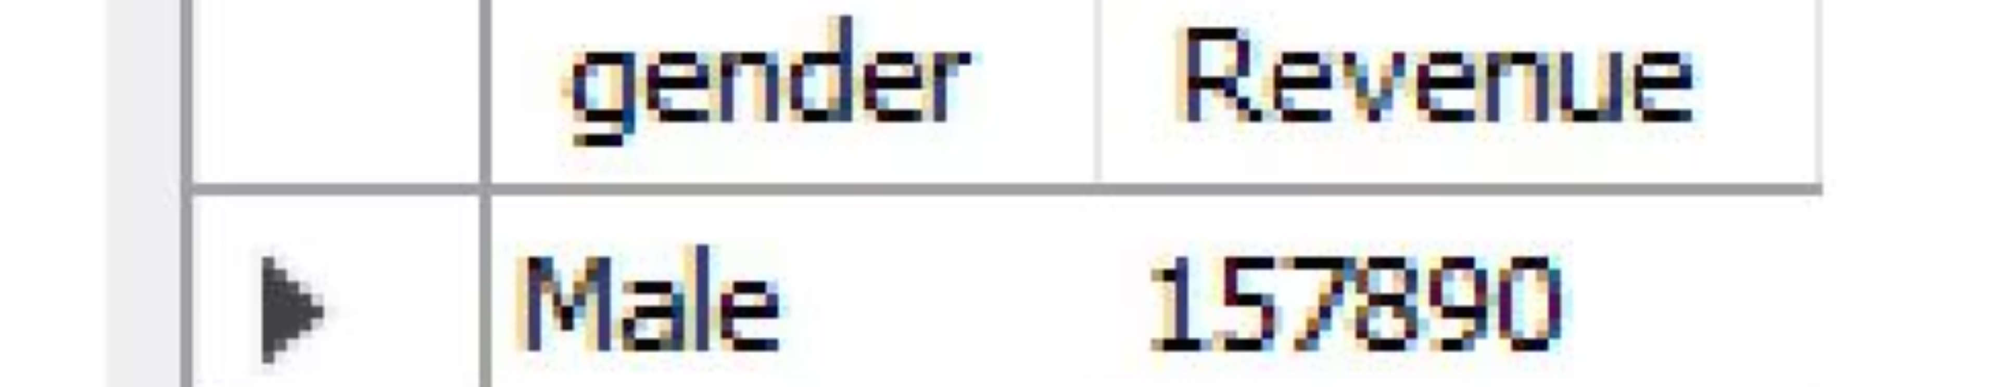
Revenue Analysis by Gender
Male Customers
Female Customers
Higher total revenue due to larger customer base
Comparable average spend per transaction

Slide 6
Product Performance Insights
Top Rated: Gloves
Sandals
Boots
3.86 average rating
3.84 average rating
3.82 average rating
Most Purchased by Category
Clothing
Accessories
Blouse (171 orders)
Jewelry (171 orders)
Pants (171 orders)
Sunglasses (161 orders)
Footwear
Outerwear
Sandals (160 orders)
Jacket (163 orders)
Shoes (150 orders)
Coat (161 orders)

Slide 7
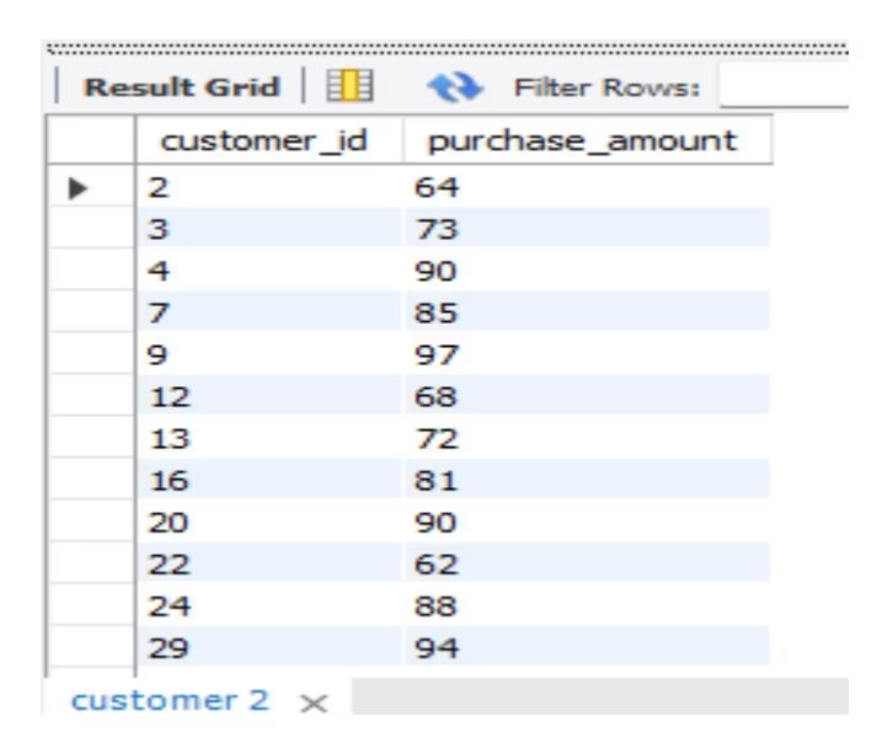
Discount & Promotion Impact
High-Value Discount Users
Customers using discounts while spending above average
43%
Discount Usage Rate
Top Discounted Products
Hat (50% discount rate)
Sneakers (49.66%)
Coat (49.07%)
Sweater (48.17%)
Pants (47.37%)

Slide 8



Customer Segmentation
1
New (83)
2
Returning (701)
3
Loyal (3,116)
Customer classification based on purchase history reveals strong loyalty base
Subscription Status
Repeat Buyers
Subscribers: 1,053 customers
958 subscribers with 5+ purchases
Non-subscribers: 2,847 customers
2,518 non-subscribers with 5+ purchases
Average spend similar across both groups
Opportunity to convert repeat buyers

Slide 9
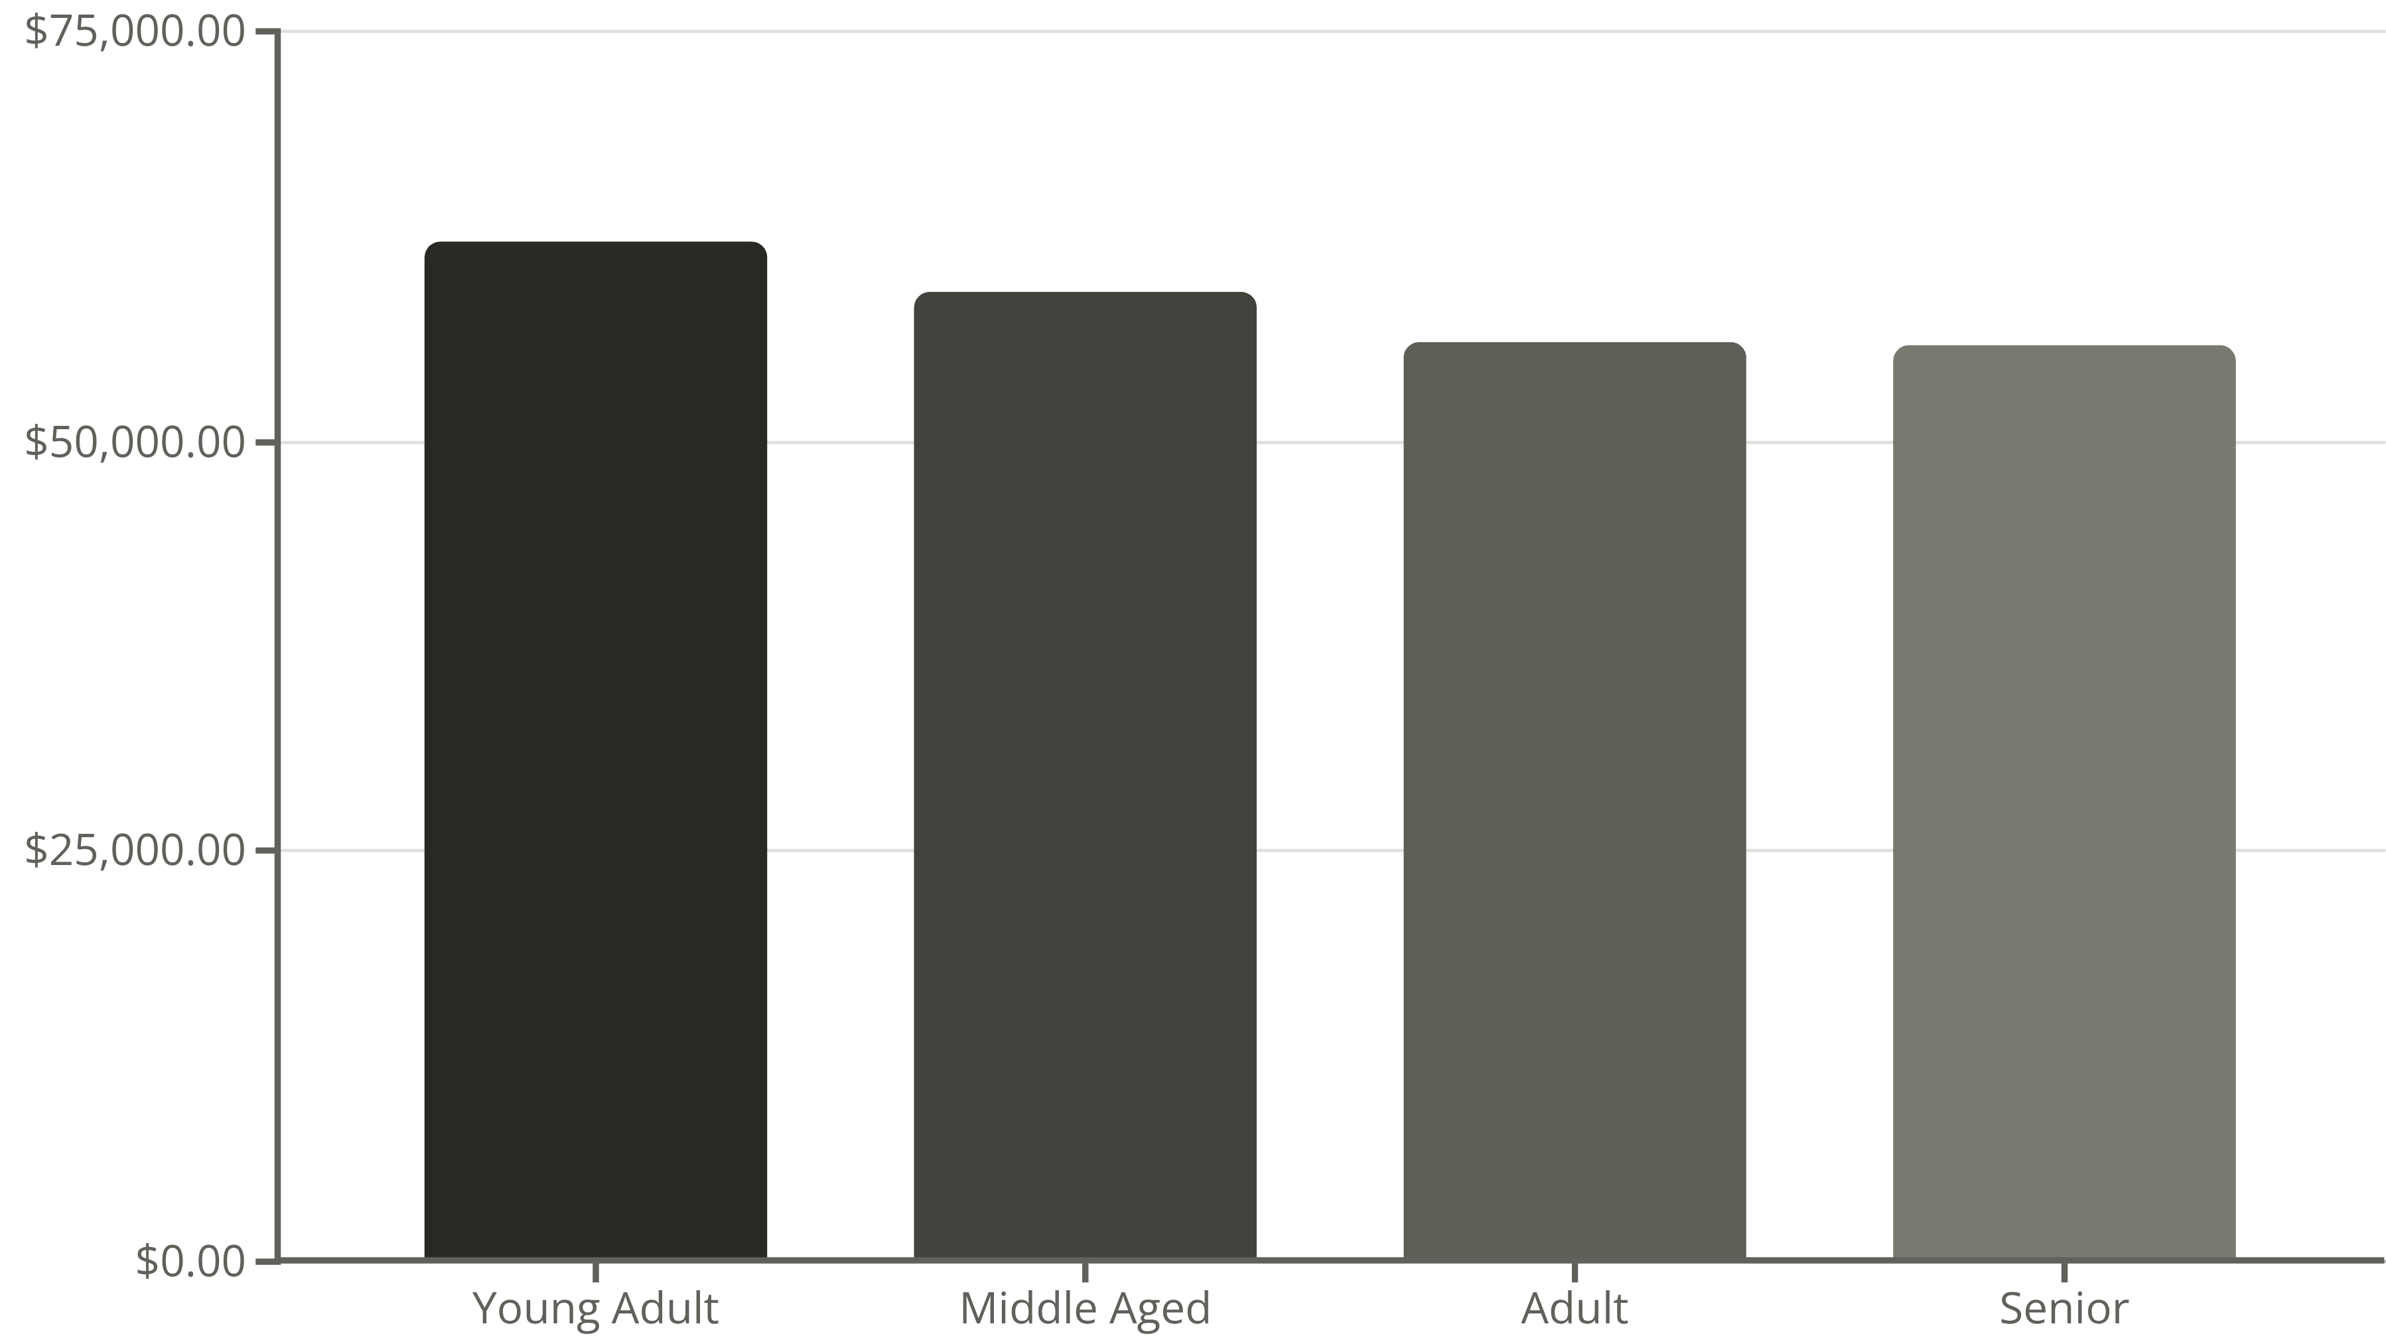
Revenue by Age Group
Shipping Preferences
Key Insight
Express: $60.48 avg spend
Young adults drive highest revenue; express shipping correlates with higher spend
Standard: $58.46 avg spend

Slide 10
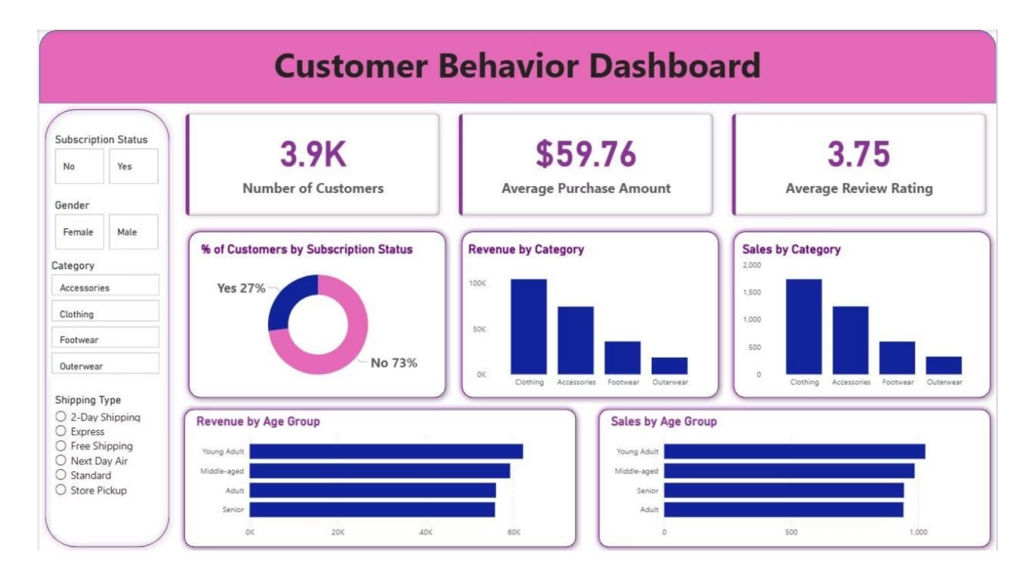

Strategic Recommendations
Boost Subscriptions
Loyalty Programs
Optimize Discounts
Promote exclusive benefits to convert 2,518 repeat buyers
Reward repeat buyers to strengthen loyal segment
Balance sales growth with margin control
Targeted Marketing
Product Positioning
Focus on young adults and express-shipping users
Highlight top-rated items in campaigns

